Slide 1
3 Scenarios When to use MongoDB!

Slide 2
Agenda
Today we will take you through the following:
NoSQL vs SQL
CAP Theorem
MongoDB Unleashed
MongoDB Market Demand
Companies using MongoDB
3 Scenarios where MongoDB suits best
(Hands ON)

Slide 3
NoSQL vs SQL

Slide 4
NoSQL vs SQL
Non-relational
Relational
NoSQL
SQL
Document based
Key-value pairs etc..
Table based
Dynamic schema
Predefined schema
Horizontally scalable
Vertically scalable
Not good fit for complex queries
Good fit for the complex query
Emphasizes on ACID properties
( Atomicity, consistency, isolation and durability)
Follows the CAP theorem
( consistency, availability and partition tolerance )

Slide 5
CAP Theorem

Slide 6
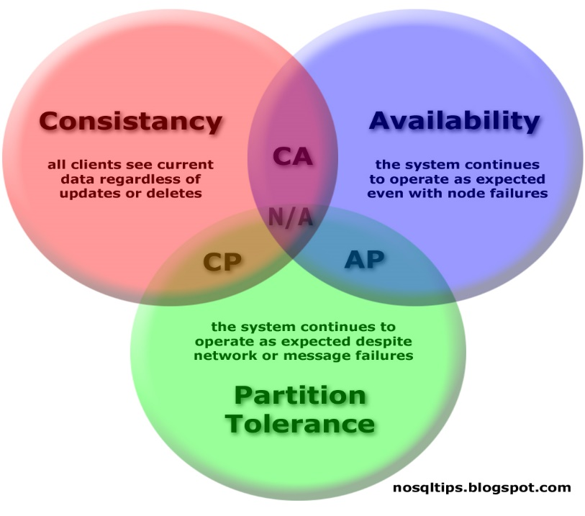
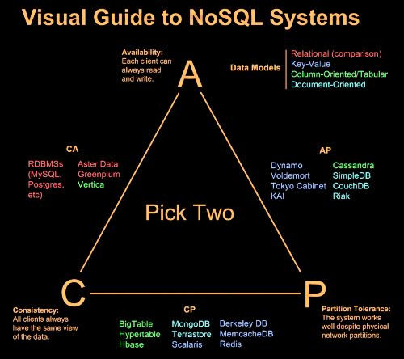
CAP Theorem
It is impossible for a distributed computer system to simultaneously provide all three of the following guarantees :
Consistency (all nodes see the same data at the same time)
Availability (a guarantee that every request receives a response about whether it succeeded or failed)
Partition tolerance (the system continues to operate despite arbitrary partitioning due to network failures)

Slide 7
MongoDB and its Top Features

Slide 8
What is MongoDB
MongoDB
free and open-source software
cross-platform document-oriented database
JSON-like documents with dynamic schemas

Slide 9
MongoDB Features
Document-Oriented
Store the business subject in the minimal number of documents e.g. instead of storing title and author information in two distinct relational structures, title, author, and other title-related information can all be stored in a single document called Book
Ad hoc Queries
MongoDB supports search by field, range queries, regular expression searches
Queries can return specific fields of documents and also include user-defined JavaScript functions
Indexing
Any field in a MongoDB document can be indexed
Secondary indices are also available

Slide 10
MongoDB Features
Document-Oriented
Store the business subject in the minimal number of documents e.g. instead of storing title and author information in two distinct relational structures, title, author, and other title-related information can all be stored in a single document called Book
Ad hoc Queries
MongoDB supports search by field, range queries, regular expression searches
Queries can return specific fields of documents and also include user-defined JavaScript functions
Indexing
Any field in a MongoDB document can be indexed
Secondary indices are also available

Slide 11
MongoDB Features
Document-Oriented
Store the business subject in the minimal number of documents e.g. instead of storing title and author information in two distinct relational structures, title, author, and other title-related information can all be stored in a single document called Book
Ad hoc Queries
MongoDB supports search by field, range queries, regular expression searches
Queries can return specific fields of documents and also include user-defined JavaScript functions
Indexing
Any field in a MongoDB document can be indexed
Secondary indices are also available

Slide 12
MongoDB Features
Replication
MongoDB provides high availability with replica sets i.e.
A replica set consists of two or more copies of the data
Each replica set member may act in the role of primary or secondary replica at any time
When a primary replica fails, the secondary should become the primary
Load Balancing
MongoDB scales horizontally using sharding i.e.
The user chooses a shard key, which determines how the data in a collection will be distributed
The data is split into ranges (based on the shard key) and distributed across multiple shards
File storage
MongoDB can be used as a file system, taking advantage of multiple machines for storing files
Exposes functions for file manipulation and content to developers
Load-balanced and fault-tolerant system

Slide 13
MongoDB Features
Replication
MongoDB provides high availability with replica sets i.e.
A replica set consists of two or more copies of the data
Each replica set member may act in the role of primary or secondary replica at any time
When a primary replica fails, the secondary should become the primary
Load Balancing
MongoDB scales horizontally using sharding i.e.
The user chooses a shard key, which determines how the data in a collection will be distributed
The data is split into ranges (based on the shard key) and distributed across multiple shards
File storage
MongoDB can be used as a file system, taking advantage of multiple machines for storing files
Exposes functions for file manipulation and content to developers
Load-balanced and fault-tolerant system

Slide 14
MongoDB Features
Replication
MongoDB provides high availability with replica sets i.e.
A replica set consists of two or more copies of the data
Each replica set member may act in the role of primary or secondary replica at any time
When a primary replica fails, the secondary should become the primary
Load Balancing
MongoDB scales horizontally using sharding i.e.
The user chooses a shard key, which determines how the data in a collection will be distributed
The data is split into ranges (based on the shard key) and distributed across multiple shards
File storage
MongoDB can be used as a file system, taking advantage of multiple machines for storing files
Exposes functions for file manipulation and content to developers
Load-balanced and fault-tolerant system

Slide 15
MongoDB Features
Aggregation
MapReduce can be used for batch processing of data and aggregation operations
The aggregation framework enables users to obtain the kind of results for which the SQL GROUP BY clause is used
Server-side JavaScript execution
JavaScript can be used in queries, aggregation functions (such as MapReduce) and sent directly to the database to be executed
Capped Collections
Supports fixed-size collections called capped collections
This type of collection maintains insertion order and once the specified size has been reached, behaves like a circular queue

Slide 16
MongoDB Features
Aggregation
MapReduce can be used for batch processing of data and aggregation operations
The aggregation framework enables users to obtain the kind of results for which the SQL GROUP BY clause is used
Server-side JavaScript execution
JavaScript can be used in queries, aggregation functions (such as MapReduce) and sent directly to the database to be executed
Capped Collections
Supports fixed-size collections called capped collections
This type of collection maintains insertion order and once the specified size has been reached, behaves like a circular queue

Slide 17
MongoDB Features
Aggregation
MapReduce can be used for batch processing of data and aggregation operations
The aggregation framework enables users to obtain the kind of results for which the SQL GROUP BY clause is used
Server-side JavaScript execution
JavaScript can be used in queries, aggregation functions (such as MapReduce) and sent directly to the database to be executed
Capped Collections
Supports fixed-size collections called capped collections
This type of collection maintains insertion order and once the specified size has been reached, behaves like a circular queue

Slide 18
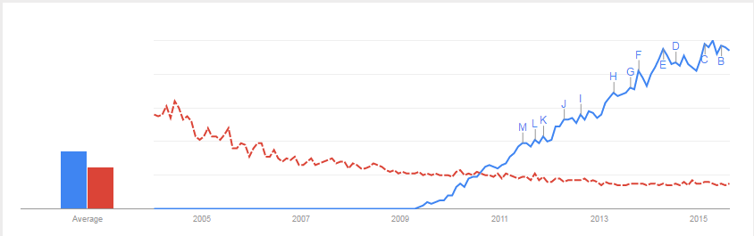
MongoDB Search Trend
MongoDB is searched more over traditional RDBMS :
Interest over time
MongoDB
RDBMS
Source : Google Trends

Slide 19
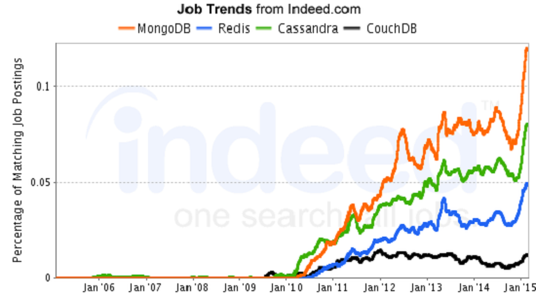
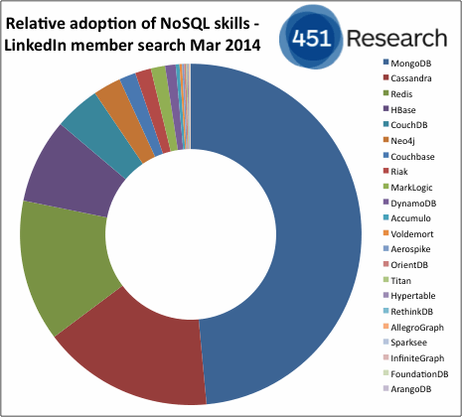
MongoDB Job And Market Trend
As per indeed.com and linkedin there are most job posting for MongoDb and the skill index is continuously growing :
Source : linkedin

Slide 20





Companies using MongoDB

Slide 21
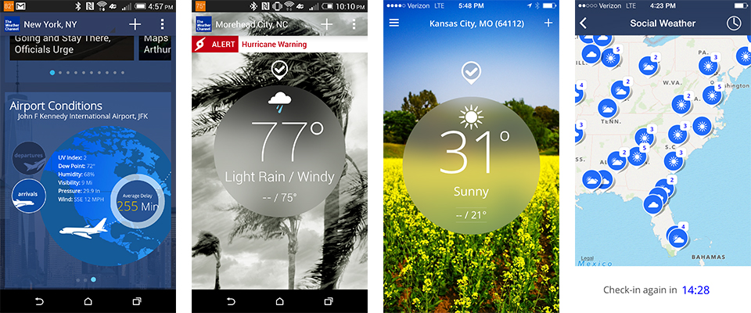
MongoDB Application
The Weather Channel turned to MongoDB to get killer features out to users quickly

Slide 22
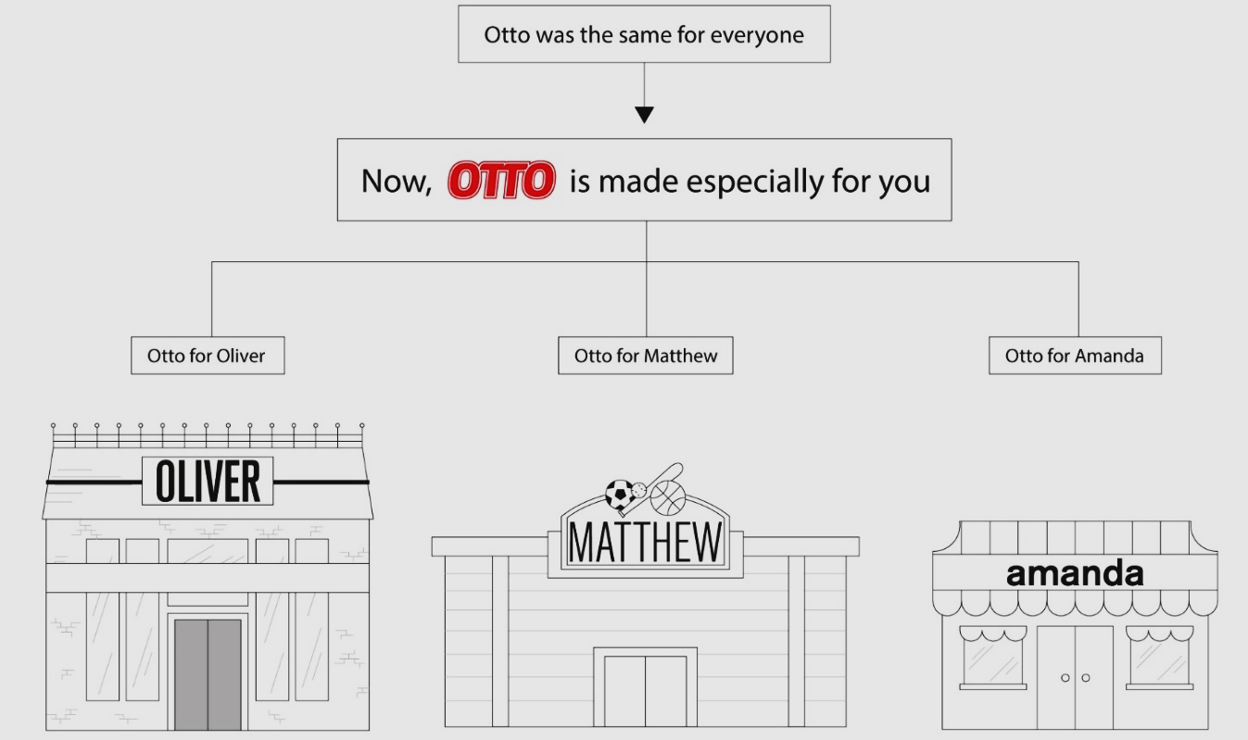
MongoDB Application
Otto Reinvents E-commerce Personalization for More than 2 Million Visitors Per Day with MongoDB

Slide 23

MongoDB Application
Rethinking The Customer Experience at Metlife: From Stalled to Success in Three Months with MongoDB

Slide 24
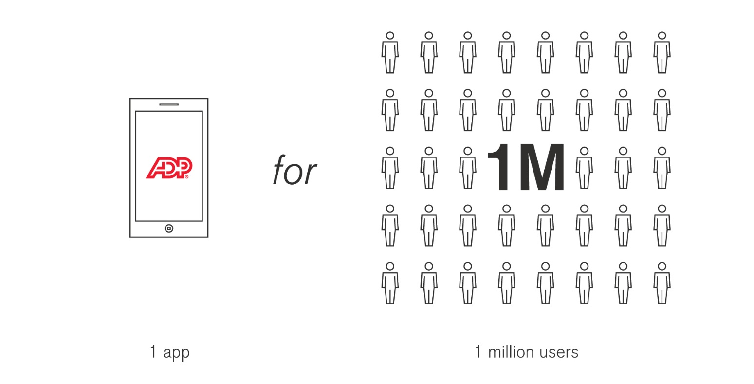
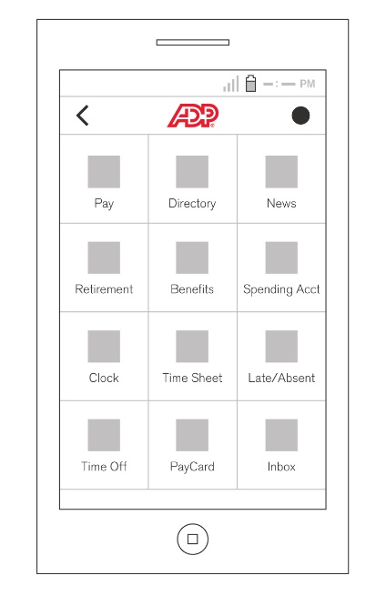
MongoDB Application
ADP: Meeting Mobile Demands, One Innovative App at a Time

Slide 25
3 Scenarios How Expedia uses MongoDB

Slide 26
Scenario 1
When you need your results in real time inspite of changing schema
MongoDB’s flexible document store and simple horizontal scale-out make it possible for Expedia to create a feature that gives every user a relevant, seamless shopping experience.
That collects highly-dynamic customer information in real-time and presents personalized offers on the fly.

Slide 27
Scenario 2
When you need flexible data model
MongoDB’s flexible data model makes it easy to store any combination of city pairs, dates and destinations.
Expedia can even continue shopping for someone after that customer has closed out a session. When the customer returns, all the latest pricing and availability for their searches are displayed side by side on their Scratchpad.

Slide 28
Scenario 3
When you need indexing
MongoDB's rich indexes are used to power analytics that make personalized suggestions to users while they shop. Expedia can also analyze patterns to pinpoint trends that offer a better understanding of what customers are looking for.
For a consumer, personalization saves time, saves money, and gets them one step closer to what they’re really after i.e. a cool vacation.
For Expedia, real-time personalization powered by MongoDB means customer loyalty, increased conversions and a competitive edge that goes straight to the bottom line.

Slide 30
Survey

